Slide 1
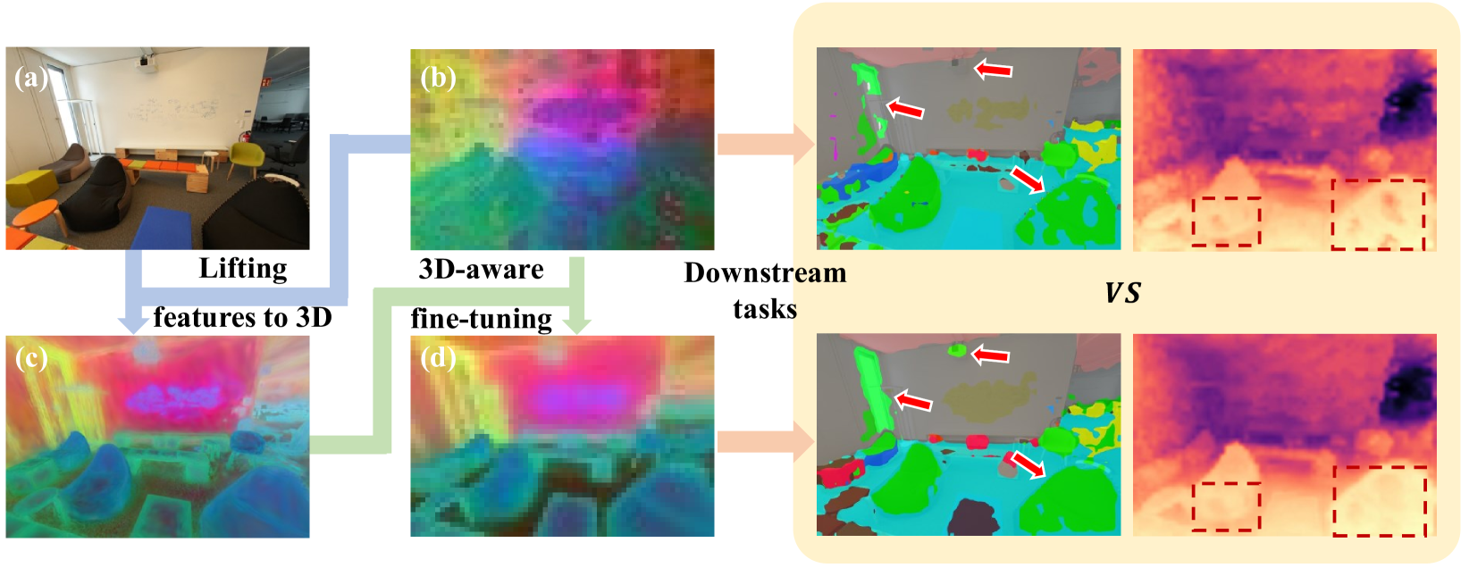
FiT3D
Improving 2D Feature Representations by 3D-Aware Fine-Tuning

Slide 2
Introduction to the problem
Problem → Current vision models trained on 2D images lack true 3D scene understanding.
Motivation → Human vision uses 3D structure cues for better understanding. Models should do the same.
Proposal → A two-stage pipeline
  Lift 2D features to a 3D Gaussian representation
  Use the rendered 3D-aware features to fine-tune 2D models.

Slide 3
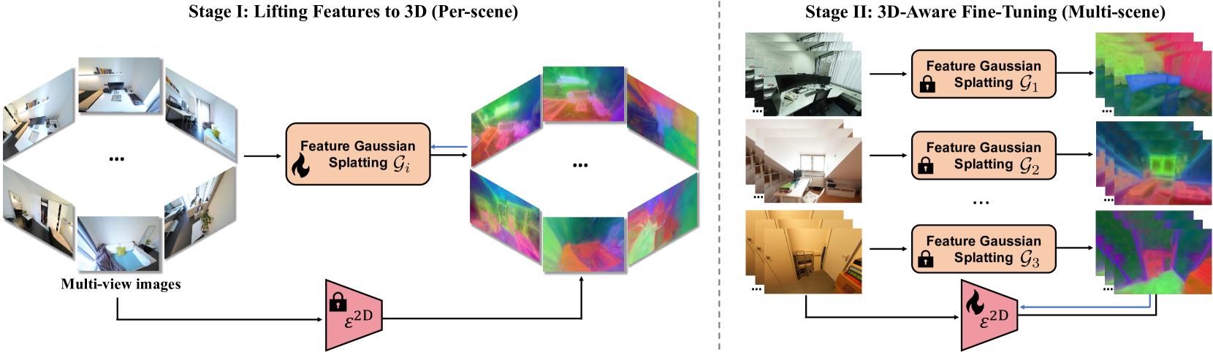
Method
Lifting features to 3D with Feature Gaussian Splatting
Fine-Tuning models with 3D-Awareness

Slide 4
Stage 1, Lifting features to 3D: How?
Multi-view 2D features are encoded into 3D Gaussians
A 3D Gaussian in this context represents a spatial point with appearance and feature attributes
Where:
Mu is the position
s is the scale, R the rotation
Alpha is the opacity
SH is the colour parameters
f is a low-dim feature vector distilled from 2D features

Slide 5
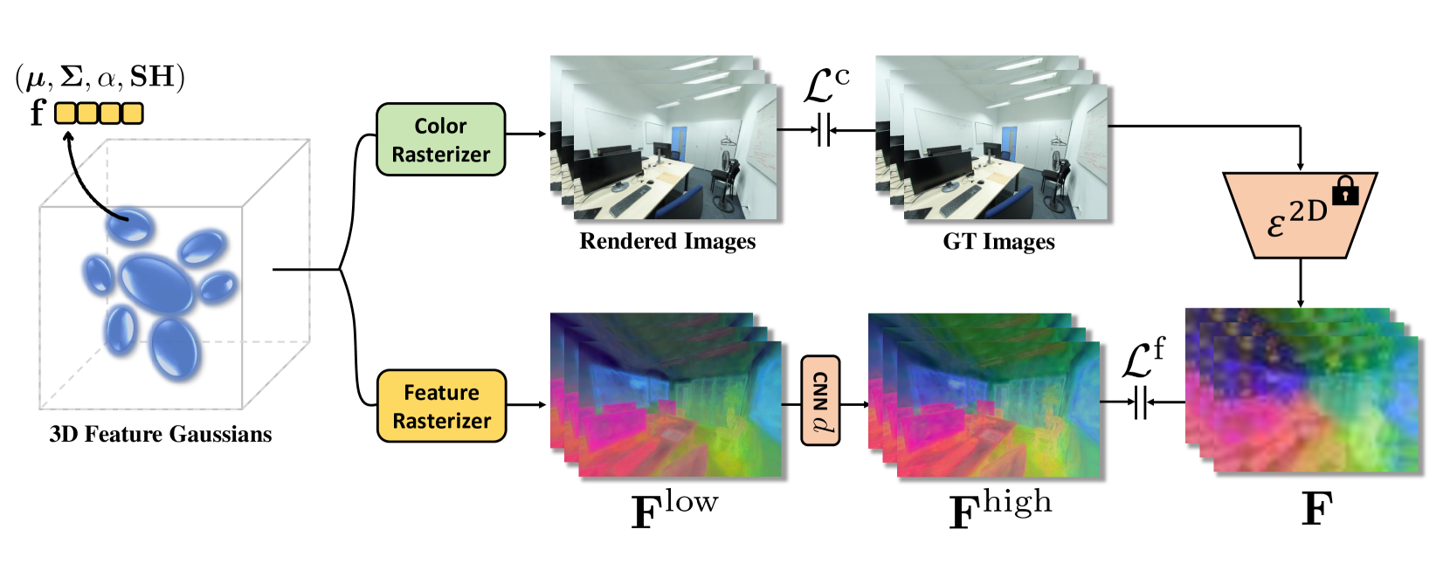
3D Gaussian Splats and Feature Rasterization
To convert 3D Gaussians to a 2D feature image, we use a differentiable rasterizer: Alpha compositing, summing constribution of overlapping Gaussians
A small scene-specific CNN is trained to transpose low-dim features back to high-dim space after rendering

Slide 6
Stage 2, 3D-Aware Fine-Tuning
The Fine-Tuning algorithm is summarized as follows:
  Load the 3D Gaussians into CPU memory
  Each training step:
    Sample a training image 𝐼𝑖 and its camera pose 𝑃𝑖.
    Retrieve the corresponding 3D Gaussian 𝐺 and scene-specific CNN decoder 𝑑
    Render the 3D-aware features for the current view using 𝐺 and 𝑑
    Compute L1 loss between rendered features and 2D model output
    Update Theta via backpropagation

Slide 7
Linear Probing for Downstream Tasks
Evaluation is done by training a shallow linear layer on top of extracted features (Linear Probing)
Semantic segmentation → Done trough ViT tokens (patches), with the output upsampled to full resolution
Depth Estimation → [CLS] token combined with each patch’s feature to map them to depth bin probabilities and selects one from it, using cross-entropy as classification loss

Slide 8
Experiments
Evaluation
  Linear probing on semantic segmentation and depth estimation
Models tested
  DINOv2 (Main)
  CLIP, MAE, DeiT-III (for generalization)
injecting 3D-awareness into 2D models improves performance on vision tasks?

Slide 9
Key Results
3D-aware features consistently outperform baseline DINOv2 on indoor datasets (ScanNet++, NYUv2, ScanNet).
Semantic Segmentation (mean Intersection over Union ↑)
  +2.6% on ScanNet++
  +2.0% on NYUv2
  +1.2% on ScanNet
Depth Estimation (Root Mean Square Error ↓)
  0.37 → 0.34 on ScanNet++
  0.44 → 0.42 on NYUv2
  0.31 → 0.29 on ScanNet
While still helping in generalized datasets evaluation (ADE20k, Pascal VOC, KITTI)

Slide 10
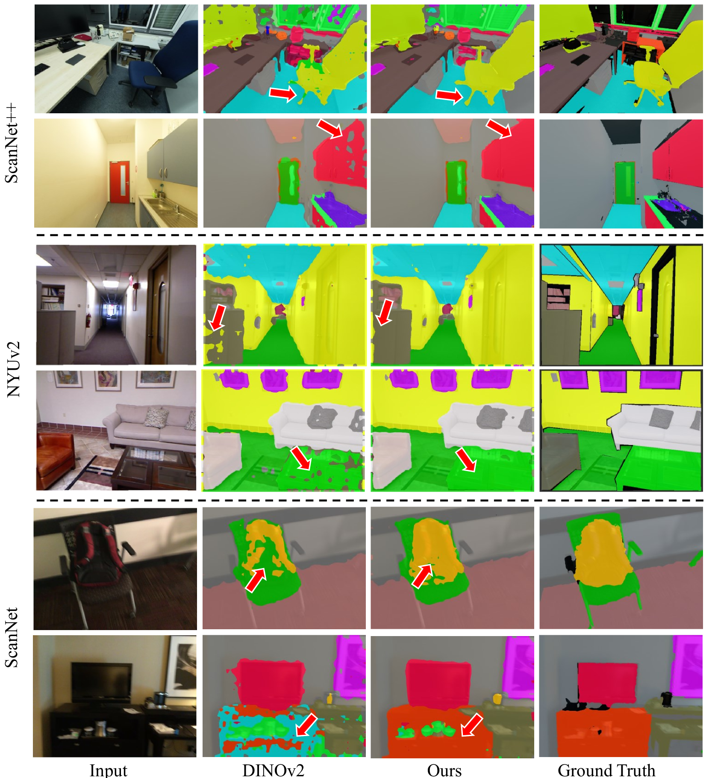
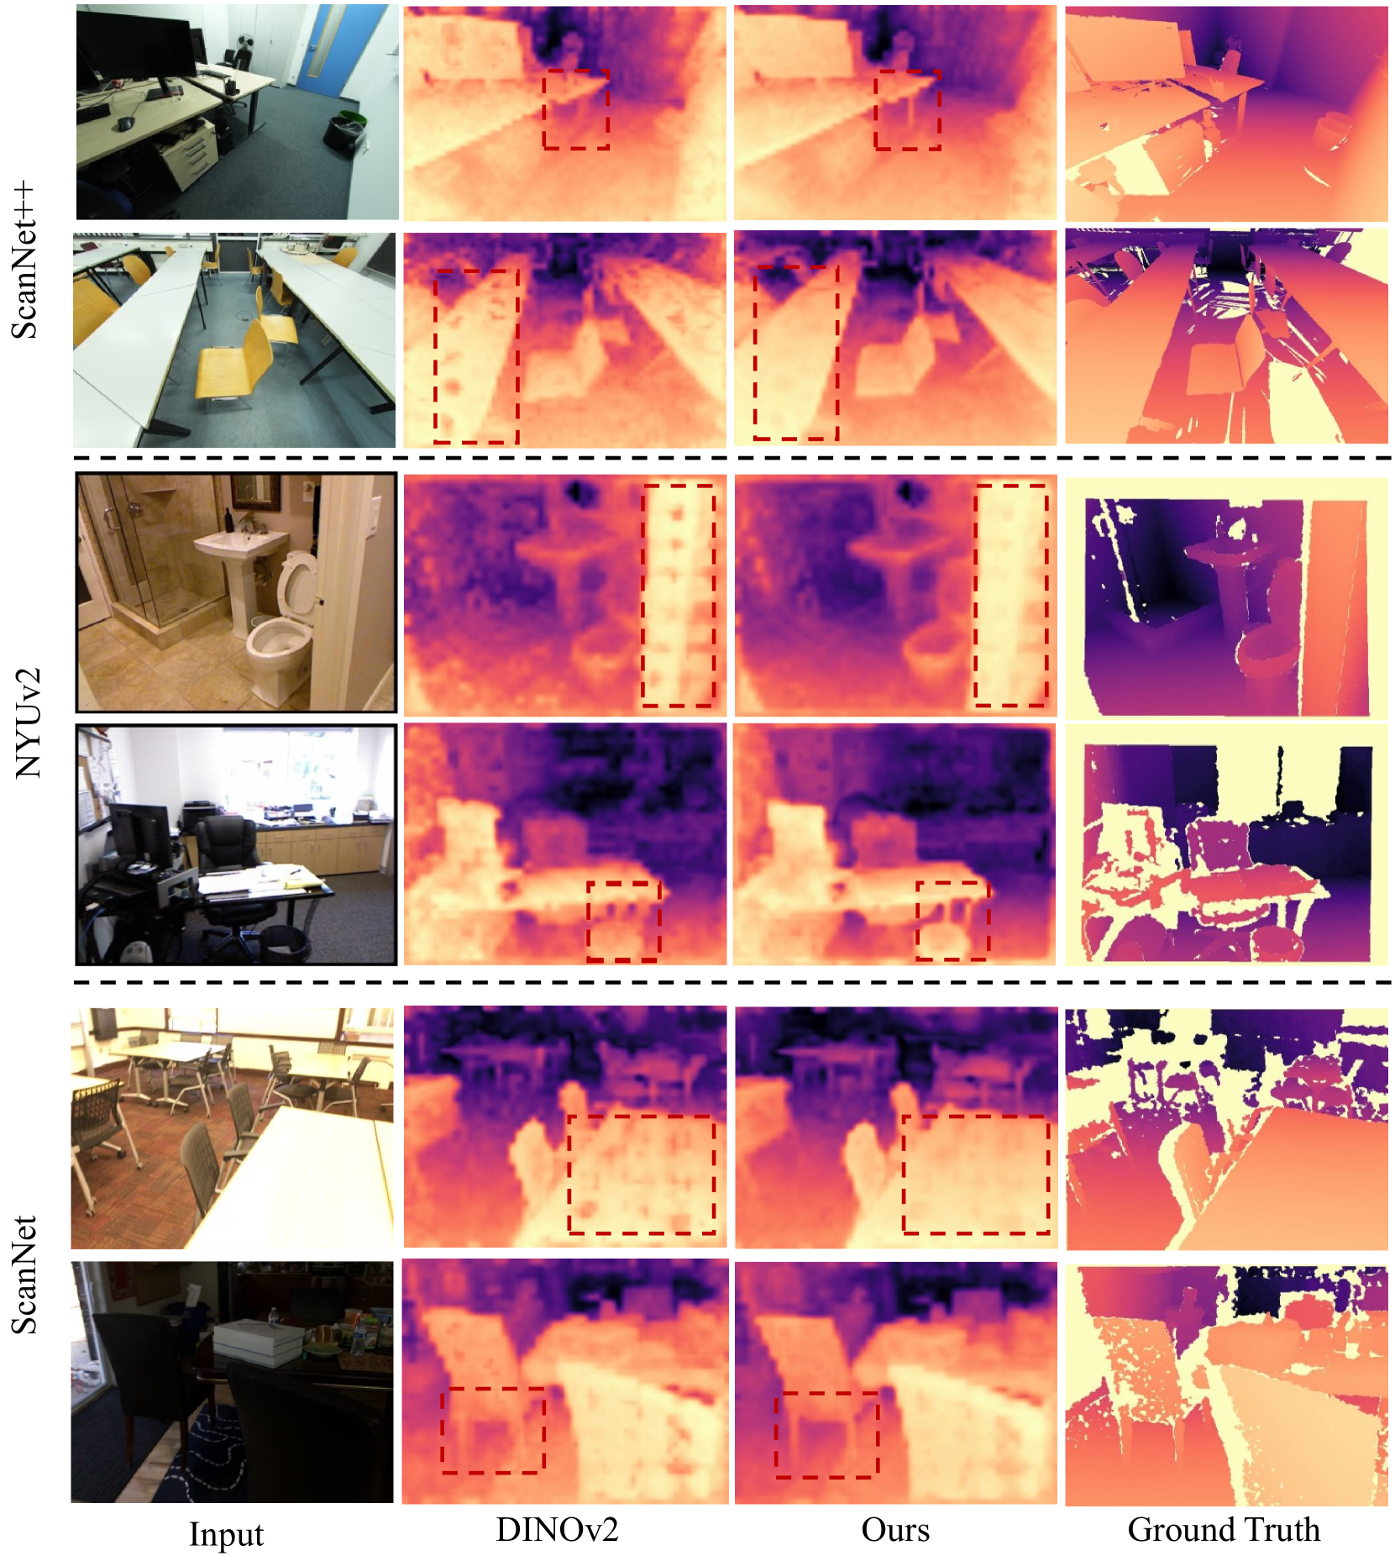

Slide 11
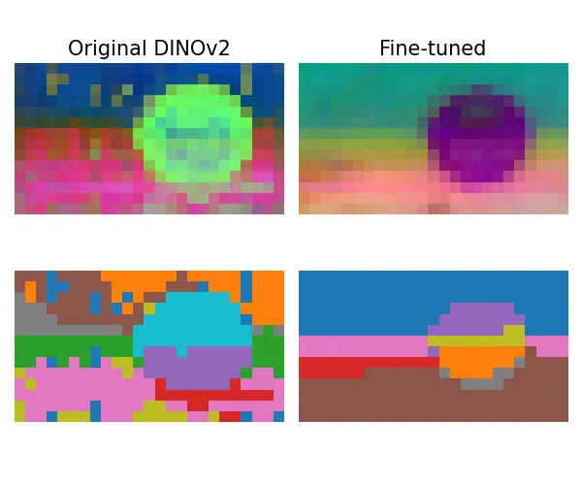
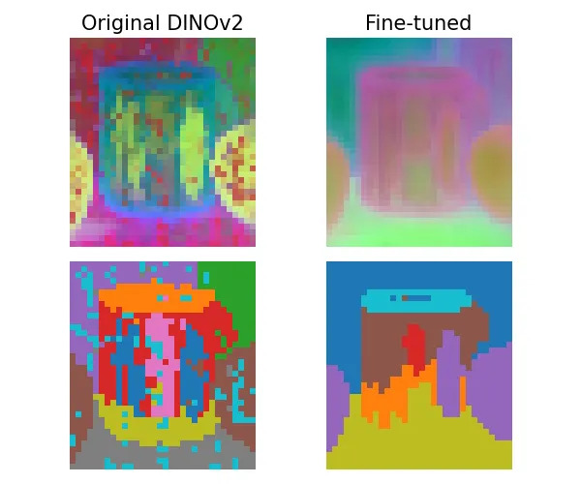
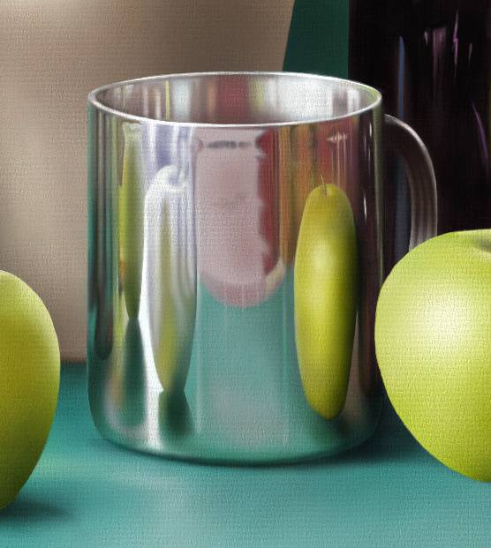

Reflective surfaces
In the self-conducted experiment, surfaces with reflective properties show how the model is able to identify objects with no noise within the reflection, but misses specific dystorted elements
The reflection is able to fool depth recognition before and after the fine tuning, showing little improvement over depth classification on a reflective surfaces
This is likely due to how Gaussian splats are calculated in the multi-view feature extraction phase

Slide 12
Ablation studies
Feature assembly strategy → The best one was to concatenate original and fine-tuned features
Fine-tuning → 1 epoch is enough in 8.5 hours
Classification tasks → There were no significant accuracy differences in the ImageNet results for classification

Slide 13
Conclusions and Key benefits
The proposed method for augmenting 3D understanding resulted in significantly better semantic + geometric performance without labels or extra architecture
Simple and scalable
Fast fine-tuning, 1 epoch
Improves multiple models
Works out-of-domain
No need for labeled data

Slide 14
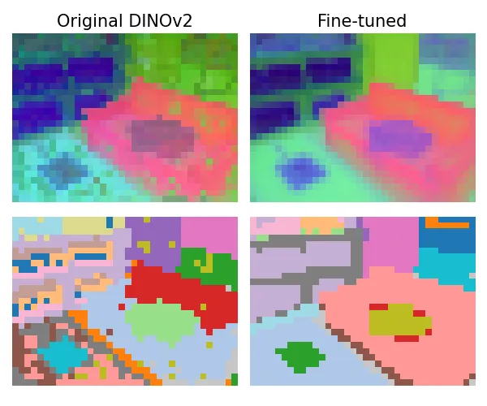
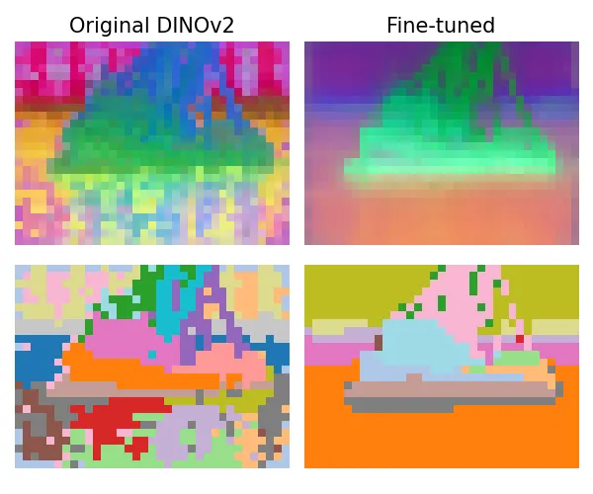
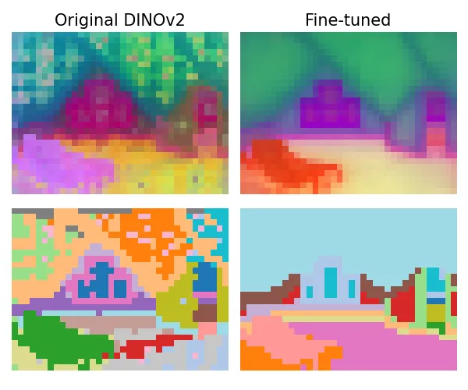
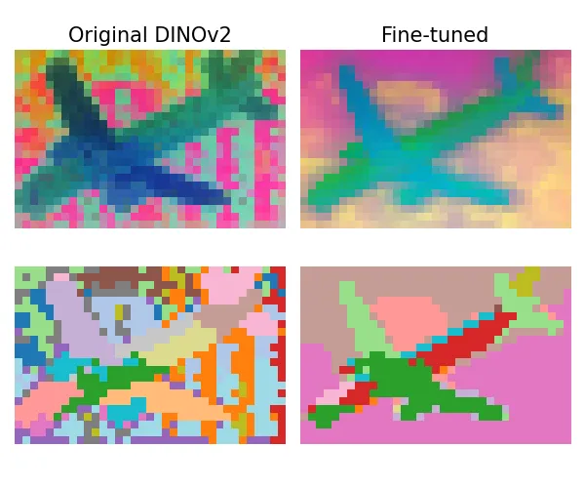
Presented by
Emanuele Di Sante

